Slide 1
Test Samples

Slide 2
(a) What is the difference between shallow and deep equality tests on Arrays in Java?
int arr1 [] = {10, 20};
int arr2 [] = arr.clone();
System.out.println(arr.equals(arr2));
System.out.println(arr1==arr2);
Shallow compare:
System.out.println(Arrays.equals(arr1, arr2));
False
False
arr1 and arr2 are two references to two different objects. So when we compare arr1 and arr2, two reference variables are compared
True

Slide 3
(a) What is the difference between shallow and deep equality tests on Arrays in Java?
int arr1 [] = {10, 20};
int arr2 [] = {10, 20};
Shallow compare:
System.out.println(Arrays.equals(arr1, arr2)); -> True
Arrays.equals() works fine and compares arrays contents.
What if the arrays contain arrays inside them or some other references which refer to different object but have same values.

Slide 4
(a) What is the difference between shallow and deep equality tests on Arrays in Java?
import java.util.Arrays;
class Test
{
public static void main (String[] args)
{
// inarr1 and inarr2 have same values
int inarr1[] = {1, 2, 3};
int inarr2[] = {1, 2, 3};
Object[] arr1 = {inarr1}; // arr1 contains only one element
Object[] arr2 = {inarr2}; // arr2 also contains only one element
if (Arrays.equals(arr1, arr2))
System.out.println("Same");
else
System.out.println("Not same");
}
}
import java.util.Arrays;
class Test
{
public static void main (String[] args)
{
// inarr1 and inarr2 have same values
int inarr1[] = {1, 2, 3};
int inarr2[] = {1, 2, 3};
Object[] arr1 = {inarr1}; // arr1 contains only one element
Object[] arr2 = {inarr2}; // arr2 also contains only one element
if (Arrays.deepEquals(arr1, arr2))
System.out.println("Same");
else
System.out.println("Not same");
}
}
Not Same
So Arrays.equals() is not able to do deep comparison.
Same
So Arrays.deepEquals() is able to do deep comparison.

Slide 5
(b) How would you backup (copy) all elements of an array to a new array using a *single* Java statement?
String [] arr = new String[3];
for (int i=0; i<3; i++)
arr[i] ="hello";
String [] arr2 = arr.clone();
for (int i=0; i<3; i++)
System.out.println(arr2[i]);
hello
hello
hello

Slide 6
(C) Provide an algorithm/pseudocode for finding the penultimate (second-last) node in a doubly linked list where the last node is indicated by a null next reference.
Node<E> first = head;
if (first==null || first.next==null)
return null;
Node<E> second = fisrt.next;
while (second.next !=null) {
first = second;
second = second.next; }
return first;

Slide 7
(d) Provide an algorithm/pseudocode to find the 𝑘th last element of a singly linked list starting with only the header sentinel?
Node<E> fast = head;
i=1;
while(fast != null && i<k) {
fast=fast.next;
i+=1; }
if (fast==null)
return null;
Node<E> slow = head;
while (fast.next!=null)
{ slow = slow.next;
fast = fast.next; }
return slow;

Slide 8
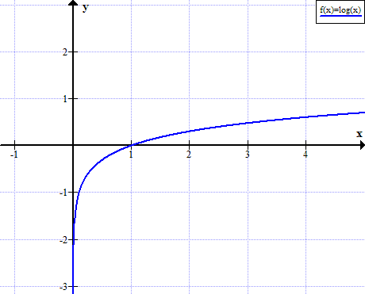
(e) Which function has the similar profile (i.e., the same “shape”) in the log-log scale as it is in the classical y/x scale? Y=log(x), an Increasing function

Slide 9
(f) How does one order these functions based on non-increasing asymptotic growth rates?

Slide 10
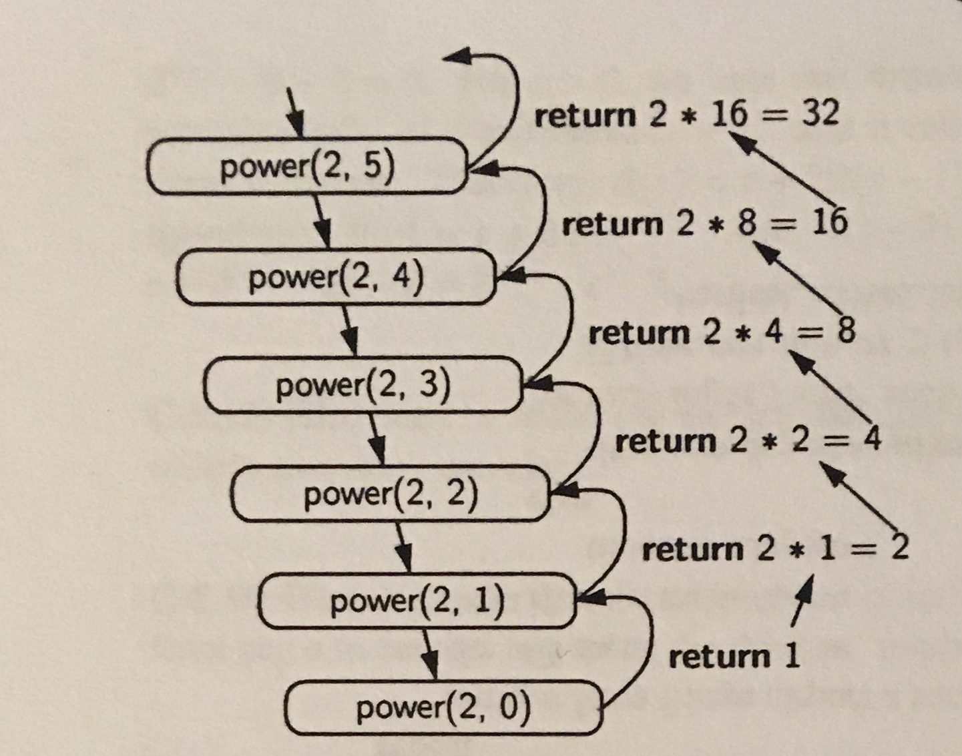
R-5.3 Draw the recursion trace for the computation of power(2,5), using the traditional algorithm implemented in Code Fragment 5.8.

Slide 11
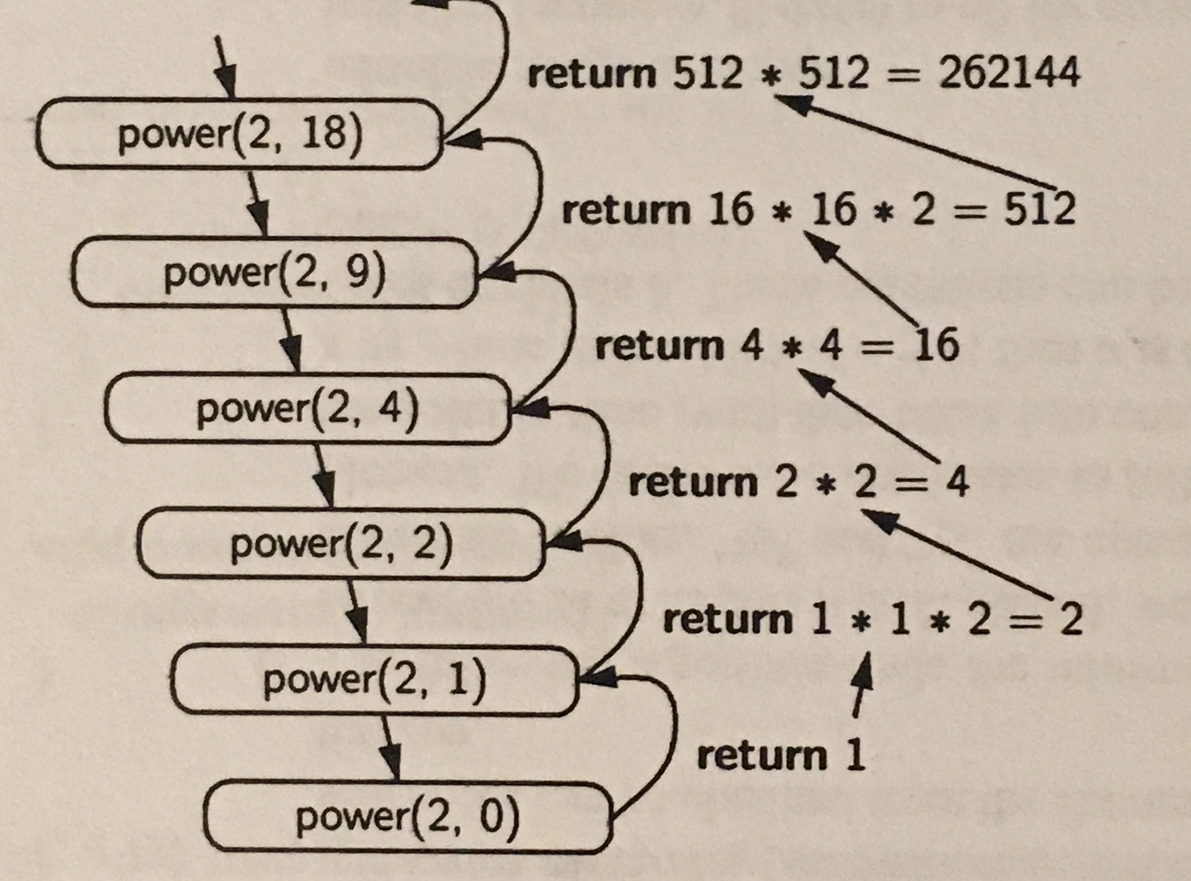
R-5.4 Draw the recursion trace for the computation of power(2,18), using the repeated squaring algorithm, as implemented in Code Fragment 5.9.

Slide 12
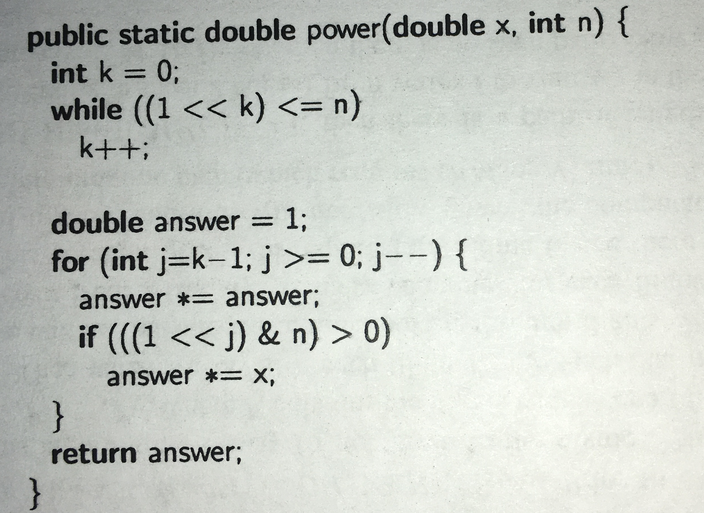
R-5.9 Develop a nonrecursive implementation of the version of the power method from Code Fragment 5.9 that uses repeated squaring.
<<:
Left shift
multiplying the number with
some power of two.
1<<2 -> 4
1<<5 -> 32

Slide 13
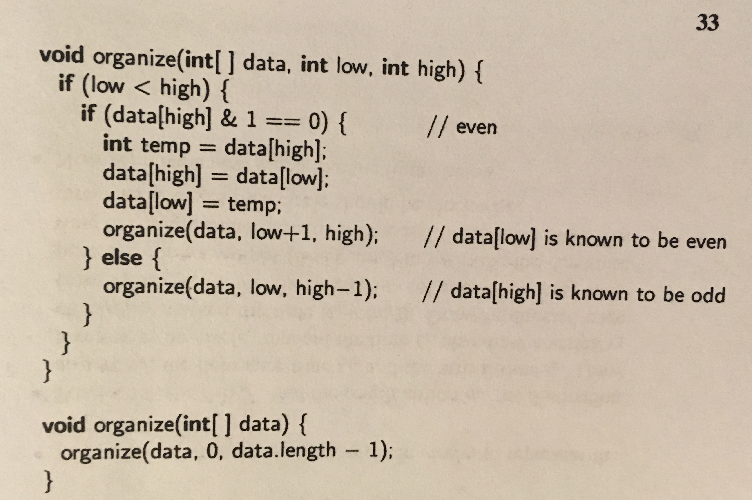

Slide 14
3, 8, 2,1,6, 7,4, 9

Slide 15
public void Remove(Stack S)
{
if (S.isEmpty())
return;
S.pop();
Remove(S); }

Slide 16
5, 3, 2, 8, 9, 1, 7, 6

Slide 17
No, It is not possible for the postorder and preorder traversal of a tree with more than one node to visit the same order.
Yes, for example: pre-order: ab post-order: ba
a
b

Slide 18
(k) When do collisions occur? (l) What are two good collision handling shcmes?
Sol: When two keys have same hash values.
Sol: Seperate Chaning
Drawbacks:
It requires the use of an auxiliary data structure to hold entries with colliding keys
Unordered List

Slide 19
(k) When do collisions occur? (l) What are two good collision handling shcmes? When two keys have same hash values.
Open Addressing
It requires that the load factor is always at most 1 and that entries are stored directly in the cells of the bucket array itself.

Slide 20
(k) When do collisions occur? (l) What are two good collision handling shcmes? When two keys have same hash values.
Open Addressing (Linear Probing)
(k,v) j=h(k)
If A[j] is empty → insert (v) in A[j]
Else try -> insert (v) in A[(j+1) mod N]
If occupied, try -> insert (v) in A[(j+2) mod N]

Slide 21
Draw the 11-entry hash table that results from using the hash function, h(i) = (4i+7) mod 11, to hash the keys 12, 44, 13, 88, 23, 94, 11, 39, 20, 16, and 5, assuming collisions are handled by chaining.
h(12) = (4 * 12 +7) mod 11 = 0
H(44) = (4 * 44 + 7) mod 11 = 7
0 | 1 | 2 | 3 | 4 | 5 | 6 | 7 | 8 | 9 | 10
12
44

Slide 22
Priority Queue
A collection of prioritized elements that allows arbitrary element insertion,
allows the removal of the element that has first priority.
When an element is added to a priority queue,
the user designates its priority by providing an associated
key.
The element with the minimal
key will be the next to be removed
from the queue

Slide 23
Priority Queue- Unsorted list
Doubly Link list is used to store <k,v> in PQ.
Insert -> at the end of the list
removeMin -> search for all items in list to find the minimum key

Slide 24
Priority Queue- Sorted list
Doubly Link list is used to store <k,v> in PQ.
Items are sorted in the list in non-decreasing order
The first item has maximum priority
Insert -> start from end, scan backward
removeMin -> remove first item
<1,C>,<2,A>,<4,B>

Slide 25
Priority Queue
Order : We need to retrieve the event with the smallest time stamp
Time stamp can be consider as the key and flight no as value

Slide 26
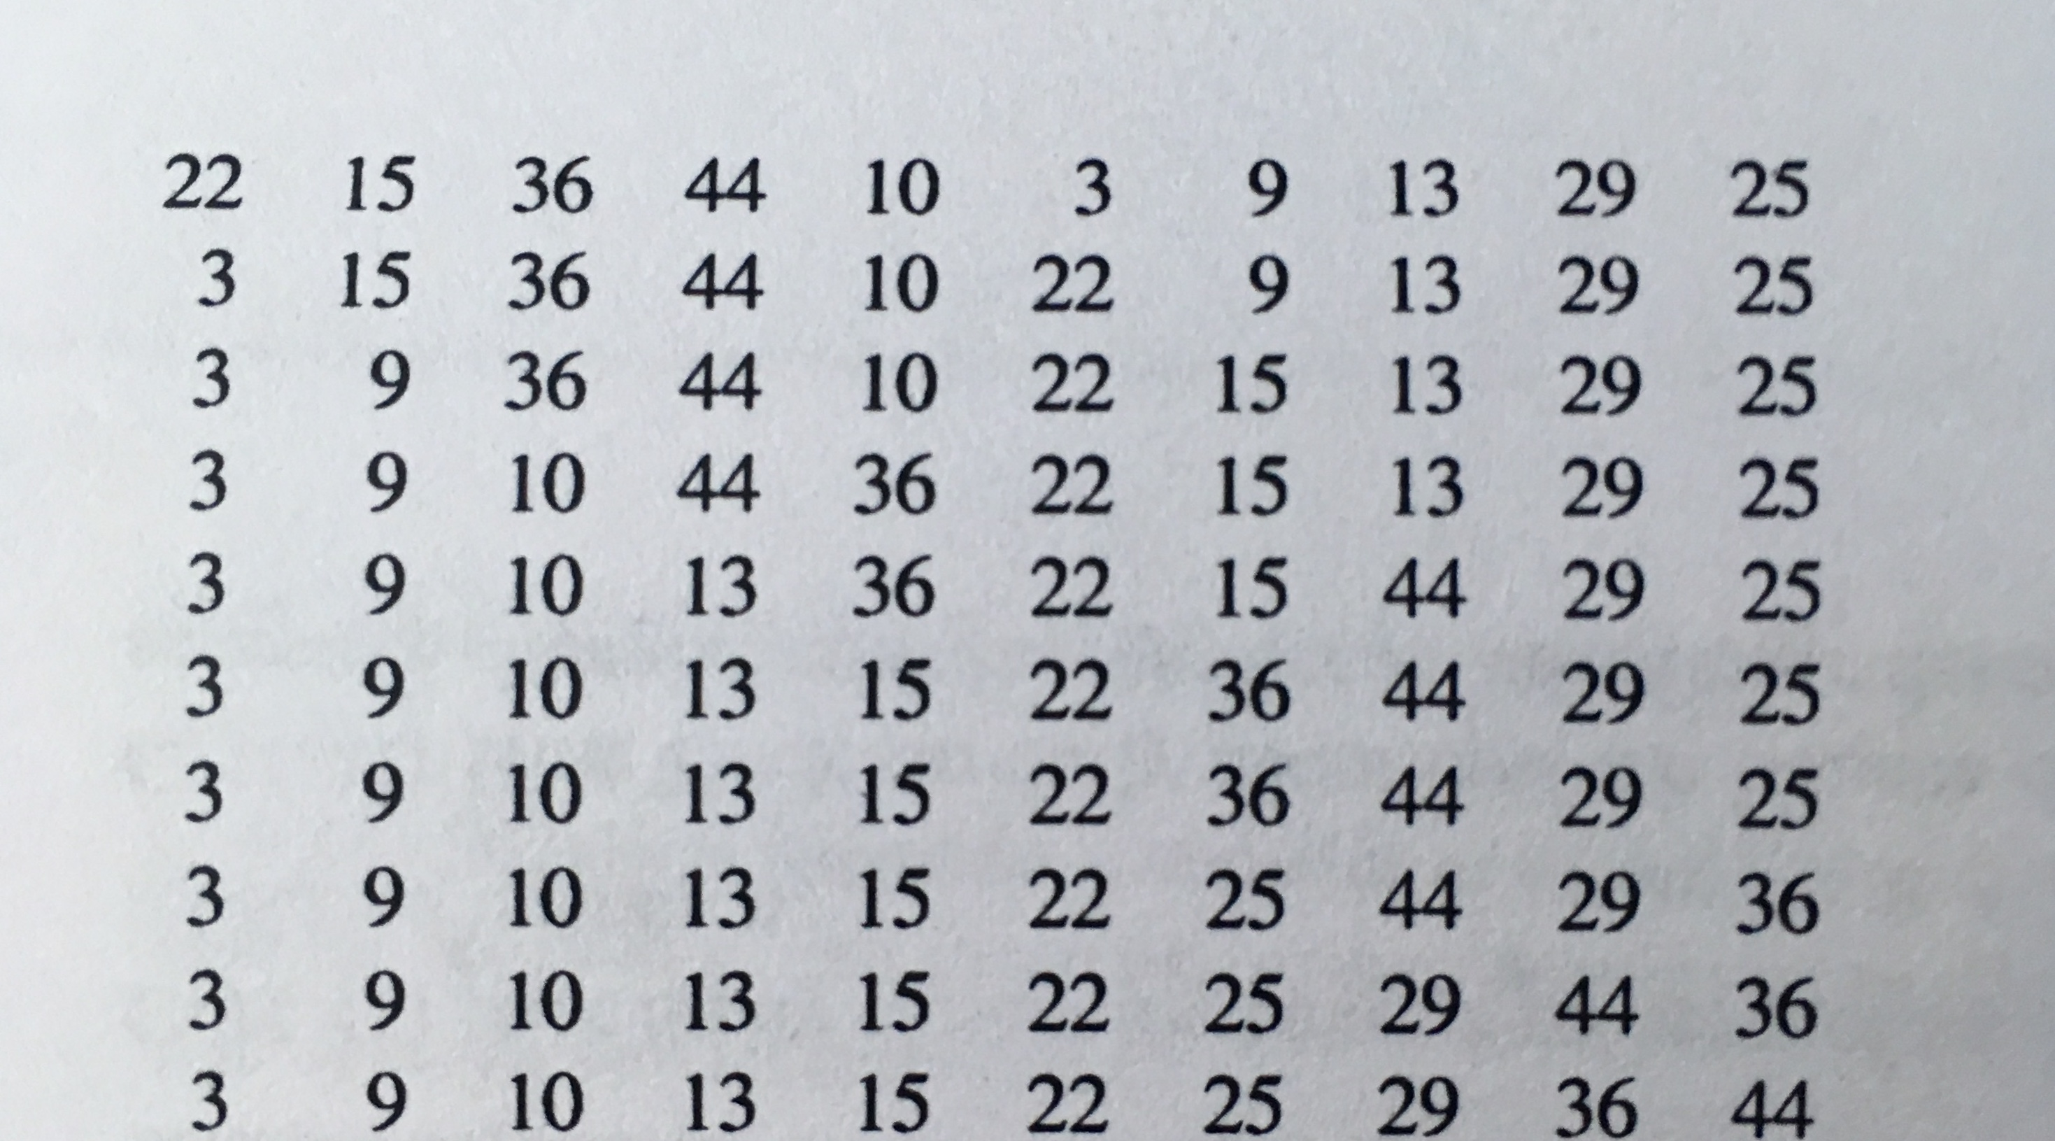

Slide 27
Priority Queue: Selection Sort
Selection Sort: at each step we select the next minimum.
Similar to Priority Queue – Unsorted list
Phase I : Insert all items from S to PQ
Phase II: removeMin from PQ and
add to the end of S.

Slide 28
Priority Queue: Insertion Sort
Insertion Sort: at each step we Insert the item in its appropriate place.
(keep the sub list sorted)
Similar to Priority Queue –sorted list

Slide 29
Input sequence is in decreasing order
44, 30, 22, 15, 12, 10, 3
44
30,44
22,30,44
15,22,30,44
10,15,22,30,44
3, 10,15,22,30,44
For each Item we start from end, moves backward and Insert at the beginning
O(n^2)

Slide 30
Heap
Heap-Order Property: In a heap T, for every position p other than the root, the key stored at p is greater than or equal to the key stored at p’s parent.
Complete Binary Tree Property: A heap T with height h is a complete binary tree if levels 0,1,2, . . . ,h−1 of T have the maximal number of nodes possible (namely, level i has 2i nodes, for 0 ≤ i ≤ h−1) and the remaining nodes at level h reside in the leftmost possible positions at that level.

Slide 31
If the smallest is at the top of the heap, the largest key in a heap may be at any external node (child, leaf)

Slide 32
BST
each internal position p stores a key-value pair (k,v) such that:
Keys stored in the left subtree of p are less than k.
Keys stored in the right subtree of p are greater than k.

Slide 33
1
2
3
4
5

Slide 34
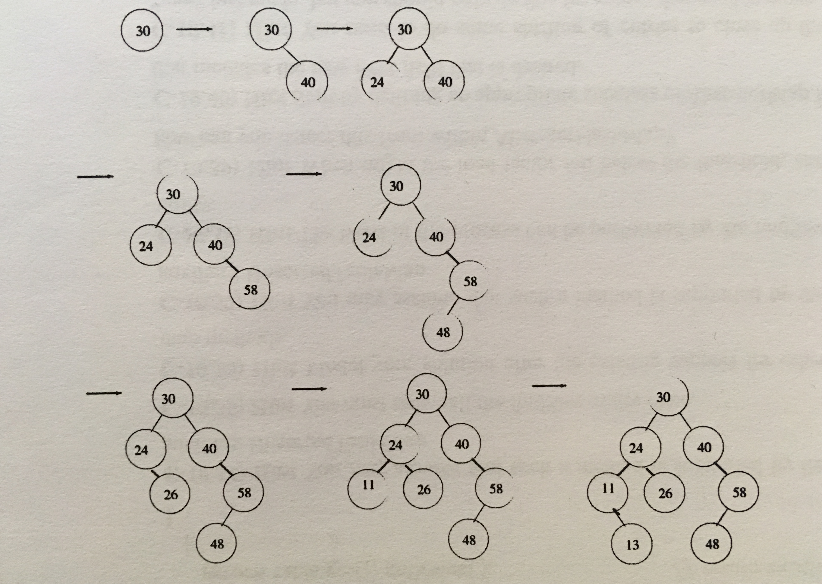
Insert, into an empty binary search tree, entries with keys 30, 40, 24, 58, 48, 26, 11, 13

Slide 35
Merge Sort O(nlog n)
Quick Sort O(n)
At first we choose a pivot then rearrange the items such that :
All item on the left side of the pivot <= pivot
All items on the right side of the pivot >= pivot
=>> O(n) => done!

Slide 36
An input list that is already sorted
If we reverse the input:
Marge-sort , heap-sort -> O(n log n)
Insertion-sort -> O(n^2)

Slide 37
Graph Representations
In an edge list, we maintain an unordered list of all edges. This minimally suffices, but there is no efficient way to locate a particular edge (u,v), or the set of all edges incident to a vertex v.

Slide 38
Graph Representations
In an adjacency list, we additionally maintain, for each vertex, a separate list containing those edges that are incident to the vertex. This organization allows us to more efficiently find all edges incident to a given vertex.

Slide 39
Graph Representations
An adjacency map is similar to an adjacency list, but the secondary container of all edges incident to a vertex is organized as a map, rather than as a list, with the adjacent vertex serving as a key. This allows more efficient access to a specific edge (u,v), for example, in O(1) expected time with hashing.

Slide 40
Graph Representations
An adjacency matrix provides worst-case O(1) access to a specific edge (u,v) by maintaining an n×n matrix, for a graph with n vertices. Each slot is dedicated to storing a reference to the edge (u,v) for a particular pair of vertices u and v; if no such edge exists, the slot will store null.

Slide 41
DFS

Slide 42
• back edges, which connect a vertex to an ancestor in the DFS tree
• forward edges, which connect a vertex to a descendant in the DFS tree
• cross edges, which connect a vertex to a vertex that is neither its ancestor nor
its descendant
Blue Edges : Tree edges
Blue Dotted : Back edges
Black Dotted : forward and cross edges

